Slide 1
Heuristics for detecting botnet coordinated attacks
Kazuya Kuwabara,
Hiroaki Kikuchi, Tokai University
Masato Terada and
Masashi Fujiwara, Hitachi Ltd.,

Slide 2
Introduction
The Cyber Clean Center (CCC) Data Set 2009.
Raw packets.
100 independent honeypots, in order for detecting behavior of downloads and the port-scans.
We discover an interesting behavior of Botnet coordinated attacks.

Slide 3
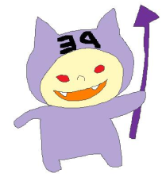
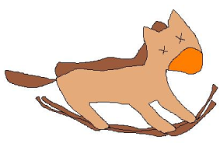
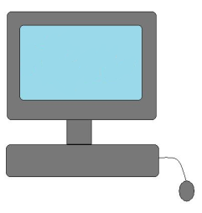
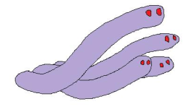
What is Coordinated Attacks?
S1
PE
Portscan
TROJ
S2
“zombie”
Herder
WORM
S3
Servers
honeyPot
Notes:
最近のボットは、機能毎にファイルが分割されていて、最初にダウンローダーを 実行した後、必要なファイルを複数ダウンロードして実行させるようになっているものもある
(ハーダーが複数のダウンロードサーバを操っている)
これを連携感染と呼ぶことにした

Slide 4
Research purposes
Our study aims to detect the coordinated attacks given captured packets.
To identify the name of malware
To predict the new attacks to be happened after the infection

Slide 5
Research issues
Detection is NOT easy because
Volume is too large : 300MB/day
Duplicated infections: 10infections within 20min
Variants of a single malware

Slide 6
List of Malware
MW | Hash
PE_VIRUT.AV | 10dfabf9141a1e96559b155338ffa4a4b43dd3d7 2cf14bfc52e7e304d2e7be114888c70e97afabda 3757741ea3fb6b3e0bdc468e2ac11baf180bede0 7ba0475332eba0d6a562694b3d5937efc1768c73 A508b8f95fb74f45b2202158f24b67d2b8dc72cb B796a1bba40ad344571734215043a73472332d94 C925531e659206849bf74abd42b5da824f795c31 F0b1add6b43bb1e84a916c3e8f88b3edfe02761b
MW | label | DL
PE_VIRUT.AV PE_BOBAX.AK PE_VIRUT.AT | PE1 PE2 PE3 | 91 4 1
BKDR_POEBOT.GN BKDR_MYBOT.AH BKDR_RBOT.ASA | BK1 BK2 BK3 | 1 30 5
TROJ_AGENT.ARWZ TROJ_BUZUS.AGB | TR1 TR2 | 6 24
WORM_ALLAPLE.IK WORM_POEBOT.AX WORM_SWTYMLAI.CD WORM_AUTORUN.CZU WORM_IRCBOT.CHZ | WO1 WO2 WO3 WO4 WO5 | 1 1 27 3 1
UNKNOWN | UK | 5
Unique MW named
13
Total MW
200
Unique Hash
24

Slide 7
3 steps to detect
1. to work out
2. to work out
3. to work out
Heuristic method

Slide 8
Heuristics for detecting attack
Rules of the coordinated Infections
Rule 1a. | Port-scan is performed after five seconds it received JOIN command.
Rule 1b. | Port-scaning host sends 256 packets per a second.
Rule 1c. | PE_VIRUT.AV scans destination addresses with 1st and 2nd octect unchanged.
Rule 2a. | WORM_SWTYMLAI.CD and TROJ_BUZUS.AGB downloaded at the same time after PE_VIRUT.AV is downloaded .
Rule 2b. | Source IP address of WORM_SWTYMLAI.CD and TROJ_BUZUS.AGB are identical.
Rule 2c. | WORM_SWTYMLAI.CD and TROJ_BUZUS.AGB use the port number of 80 and PE_VIRUT.AV uses port numbers of ve digits long.
Rule 3a. | The downloading in PUSH sends packets in constant rate.
Rule 3b. | Packets containg string, .MZ. and .PE. use TCP to download malwares.
Rule 3c. | The downloading in PUSH is made byWORM_ALLAPLE.
Rule 3d. | Downloading in TFTP, contains string .win. in UDP.
Rule 2a. | WORM_SWTYMLAI.CD and TROJ_BUZUS.AGB downloaded at the same time after PE_VIRUT.AV is downloaded .
Rule 2b. | Source IP address of WORM_SWTYMLAI.CD and TROJ_BUZUS.AGB are identical.
Rule 2c. | WORM_SWTYMLAI.CD and TROJ_BUZUS.AGB use the port number of 80 and PE_VIRUT.AV uses port numbers of five digits long.

Slide 9
TimeChart
Source
DL:PE
S1
ΔT1
DL:TORJ
S2
S3
DL:WORM
IRC connection/dst1
Portscan/dst2
NICK
JOIN
ΔT２
t0
t1
t2
t3
t4
Time

Slide 10
Examples of coordinated attacks
slot | time | srcIP | dstPort | MW
0 0 0 | 0:02:11 0:03:48 0:03:48 | 124.86.165.111 67.215.1.206 72.10.166.195 | 47556 80 80 | PE_VIRUT.AV TROJ_BUZUS.AGB WORM_SWTYMLAI.CD
2 2 2 | 0:36:46 0:36:52 0:36:52 | 124.86.61.109 72.10.166.195 67.215.1.206 | 33258 80 80 | PE_VIRUT.AV WORM_SWTYMLAI.CD TROJ_BUZUS.AGB
3 3 3 | 0:46:56 0:48:52 0:48:52 | 124.86.61.109 67.215.1.206 72.10.166.195 | 33258 80 80 | PE_VIRUT.AV TROJ_BUZUS.AGB WORM_SWTYMLAI.CD
16 16 16 | 5:17:25 5:18:37 5:18:38 | 114.145.105.239 67.215.1.206 72.10.166.195 | 15224 80 80 | PE_VIRUT.AV TROJ_BUZUS.AGB WORM_SWTYMLAI.CD

Slide 11
Number of distinct servers
MW | Distinct DL Servers
PE_VIRUT.AV | 10
TROJ_BUZUS.AGB | 1
WORM_SWTYMLAI.CD | 1
PE
TROJ
WORM
Notes:
PEをDLするサーバーは分散されている

Slide 12
Rule1c. Destination addresses
Slot | Bonet server | Honey pot | Destination
0 2 3 16 29 | 124.86.165.111 124.86.61.109 124.86.61.109 114.145.105.239 114.164.227.177 | 124.86.163.101 124.86.163.101 124.86.163.101 114.145.122.39 114.164.205.246 | 124.86.163.102 124.86.163.102 124.86.163.102 114.145.122.40 114.164.205.247
 | A.B.C.D | A.B.E.F | A.B.E.F+1
Total 17slot
Notes:
全て135番ポートを使いポートスキャンを行う

Slide 13
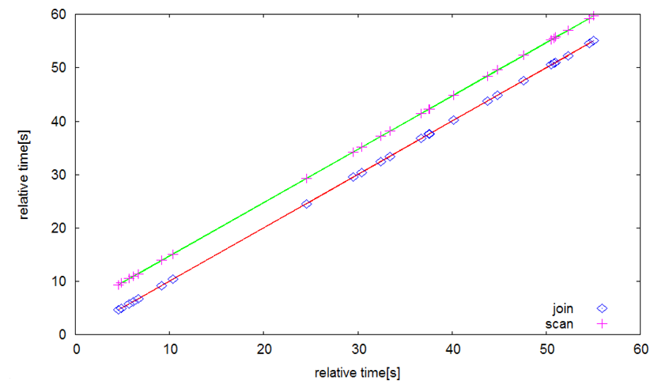
Rule 1a. Time difference
Port scan
relative time [s]
JOIN
relative time [s]

Slide 14
Statistics of coordinated infections
 |  | slot | # of slots | action
pattern1 | PE1 → TR2,WO3 | 0,2,3,16,29,30,50,60,63,69,70,71,83,94,100,130,132 | 17slot | C&C TCP(135) s4portscan
pattern2 | BK1 → TR2,WO3 | 14,55,56,125,126 | 5slot | C&C TCP(135) s4portscan
pattern3 | PE2 → WO4,WO3 | 66,139,140,141 | 4slot | C&C TCP(135) s4portscan DoSattack SMTP
PE1: PE_VIRUT.AV
TR2 : TROJ_BUZUS.AGB
WO3: WORM_SWTYMLAI.CD
BK1: BKDR_POEBOT.GN
PE2: PE_BOBAX.AK
WO4: WORM_AUTORUN.CZU

Slide 15
Rule accuracy
Rule | Frequency | accuracy
Rule 1c. | 24/145 slot | 24/38 slot 63%
Rule 2a. | 17/145 slot | 17/38 slot 45%
Rule 2b. | 22/145 slot | 22/22 slot 100%
Rule 2c. | 17/145 slot | 17/17 slot 100%
All 145 slot have been infected by malware in the slot a few 58slot .

Slide 16
Conclusion
We have studied the botnet-coordinated attack and heuristics for detecting common sequence patters.
Coordinated attack emerged at a rate of 44 percent.

Slide 18
Mail
Kazuya Kuwabara
mulberry@cs.dm.u-tokai.ac.jp
Hiroaki Kikuchi
kikn@tokai.ac.jp

