Slide 1
Mining Association rules consisting of Download Servers from Distributed Honeypot Observation
Masayuki Ohrui,
Hiroaki Kikuchi, Tokai University
Masato Terada, Hitachi Ltd.

Slide 2
Generation of Malware
1. Single
2. Variants
3. Botnet
PE
WO
TR
WORM
WORM
Coordinated
Attack
A
C
B

Slide 3
Sample of Coordinated Attack
Time | Sourse IP Address | Malware Name
0:02:11 | 124.86.***.111 | PE_VIRUT.AV
0:03:48 | 67.215.*.206 | TROJ_BUZUS.AGB
0:03:48 | 72.10.***.195 | WORM_SWTYMLAI.CD
Rule
PE_VIRUT.AV
TROJ_BUZUS.AGB
WORM_SWTYMLAI.CD
Notes:
PEをDLしたならば、TROJとWORMがDLされる

Slide 4
Objectives
Discovery of botnet coordinated attacks.
E.g.
Botnet A: PE+TROJ+WORM
Botnet B: BKDR+TSPY+WORM
Application to efficient malware detection.

Slide 5
Our Approach: Honeypot
Sunday
PE
WORM
TROJ
WO
PE
WO
1
1
2
Honeypot

Slide 6
Our Approach: Honeypot
Monday
PE
TR
PE
WORM
TROJ
TR
1
1
2
Honeypot

Slide 7
Difficulty of discovering
Week | PE1 | PE2 | TROJ1 | TORJ2 | WORM1 | WORM2
Sun | 3 |  |  | 2 | 1
Mon | 1 | 2 | 2 | 1 | 3 | 3
Tue | 2 |  | 2 |  | 1 | 2
Wed |  | 5 | 3 | 2 |  | 1
Thu | 1 |  | 1 | 4 | 3
Fri |  | 2 | 2 | 3
Sat | 3 | 1 | 1 |  | 5 | 3
Coordinated patterns: 2⁶ = 64
One week: 7
# of investigations: 448
← 400M
← 2M
← 800T
Notes:
単純な組み合わせなのでこの数だが、半数以下と見積もっても
かなりの膨大な組み合わせを調べなければいけない
7

Slide 8
Our Approach: Data mining
Using association analysis ‘Apriori’
Extracting association rules of the form X → Y.
E.g. ‘PE → WORM, TROJ’
With the minimum support and confidence, we can squeeze many useless rules to be examined.
Notes:
Xという前提条件部が来るならば、Yという結論部も来る
コンビニで例えると、ビールを購入する人は、新聞も購入するといったルールを発見できる

Slide 9
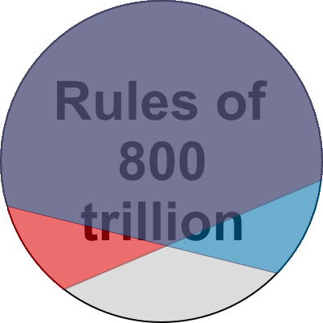
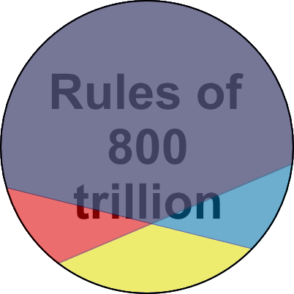
Principle of Algorithm ‘Apriori’
Given minimum values, prune useless rules.
Minimum Supp 0.8
Minimum Conf 0.6
Effective Rules

Slide 10
Extract of Association Rules
X(PE1) → Y(TROJ1 & WORM1)
Supp = |X∩Y| / |N| = 4/7 days 60 ％
Conf = |X∩Y| / |X| = 4/5 days 80 ％
Week | PE1 | PE2 | TROJ1 | TORJ2 | WORM1 | WORM2
Sun | 3 |  |  | 2 | 1
Mon | 1 | 2 | 2 | 1 | 3 | 3
Tue | 2 |  | 2 |  | 1 | 2
Wed |  | 5 | 3 | 2 |  | 1
Thu | 1 |  | 1 | 4 | 3
Fri |  | 2 | 2 | 3
Sat | 3 | 1 | 1 |  | 5 | 3
|N| = 7
|X| = 5
|X∩Y| = ４
Notes:
単純な組み合わせなのでこの数だが、半数以下と見積もっても
かなりの膨大な組み合わせを調べなければいけない
10

Slide 11
CCC DATAset 2009
CCC DATAset have observed malware traffic at the Japanese tier-1 backbone under the Cyber Clean Center (CCC).
The malware downloading logs
94 honeypot
1 year (may 1, 2008 – April 30 2009)
The captured packets data
1 honeypot
2 days (March, 13 & 14, 2009)

Slide 12
Questions
1. How accurate does Apriori algorithm detect all coordinated attacks?
2. How common were coordinated attacks observed?
3. How long were coordinated attacks performed?

Slide 13
Experimental Data
The malware downloading logs
Honeypot ID（Honey001～094）
 |  | 001 | 002 | 003 | 004 |  | 094
2008/05
2008/06
2008/07
2009/02
2009/03 | 13
 | 14
2009/04
Experiment 4
The captured packets data
1 year (365 days)
Experiment 3
Experiment 1 & 2
Experiment 1 & 2
Association Rules of Malware / DL Servers
Experiment 4
Lifecycle of Rules of Malware
Experiment 3
Dependency on Honeypot

Slide 14
Exp1: Association Rules of Malware
Minimum Supp: 10%, Minimum Conf: 80%
A manual pattern can be
extracted automatically!
No. | Antecedent |  |  | Consequent | Supp | Conf
5 | PE_ VIRUT.AV | TROJ_ BUZUS.AGB | ⇒ | WORM_ SWTYMLAI.CD | 29.3 | 100
6 | PE_ VIRUT.AV | WORM_ SWTYMLAI.CD | ⇒ | TROJ_ BUZUS.AGB | 29.3 | 100
No. | Antecedent |  |  | Consequent | Supp | Conf
1 |  | TROJ_ BUZUS.AGB | ⇒ | WORM_ SWTYMLAI.CD | 41.4 | 100
2 |  | WORM_ SWTYMLAI.CD | ⇒ | TROJ_BUZUS.AGB | 46.6 | 88.9
3 | TROJ_BUZUS.AGB | BKDR_ POEBOT.GN | ⇒ | WORM_ SWTYMLAI.CD | 10.3 | 100
4 | WORM_ SWTYMLAI.CD | BKDR_ POEBOT.GN | ⇒ | TROJ_BUZUS.AGB | 10.3 | 100
5 | PE_VIRUT.AV | TROJ_ BUZUS.AGB | ⇒ | WORM_ SWTYMLAI.CD | 29.3 | 100
6 | PE_VIRUT.AV | WORM_ SWTYMLAI.CD | ⇒ | TROJ_ BUZUS.AGB | 29.3 | 100

Slide 15
Exp2: Association Rules of DL Servers
Minimum Supp: 10%, Minimum Conf: 50%
No. | Antecedent |  | Consequent | Supp | Conf | Corresponding MW
1 | 114.145.51.166 | ⇒ | 122.18.195.123 | 41.4 | 100 | PE⇒PE
2 | 122.18.195.123 | ⇒ | 114.145.51.166 | 46.6 | 88.9 | PE⇒PE
No. | Antecedent |  | Consequent | Supp | Conf | Corresponding MW
1 | 114.145.51.166 | ⇒ | 122.18.195.123 | 41.4 | 100 | PE⇒PE
2 | 122.18.195.123 | ⇒ | 114.145.51.166 | 46.6 | 88.9 | PE⇒PE
3 | 67.215.1.206 | ⇒ | 72.10.165.195 | 10.3 | 100 | TROJ⇒WORM
4 | 72.10.166.195 | ⇒ | 67.215.1.206 | 10.3 | 100 | WORM⇒TROJ
The rules are NOT useful
Notes:
なぜ50％なのか？80でも変わらない気がする
要調査

Slide 16
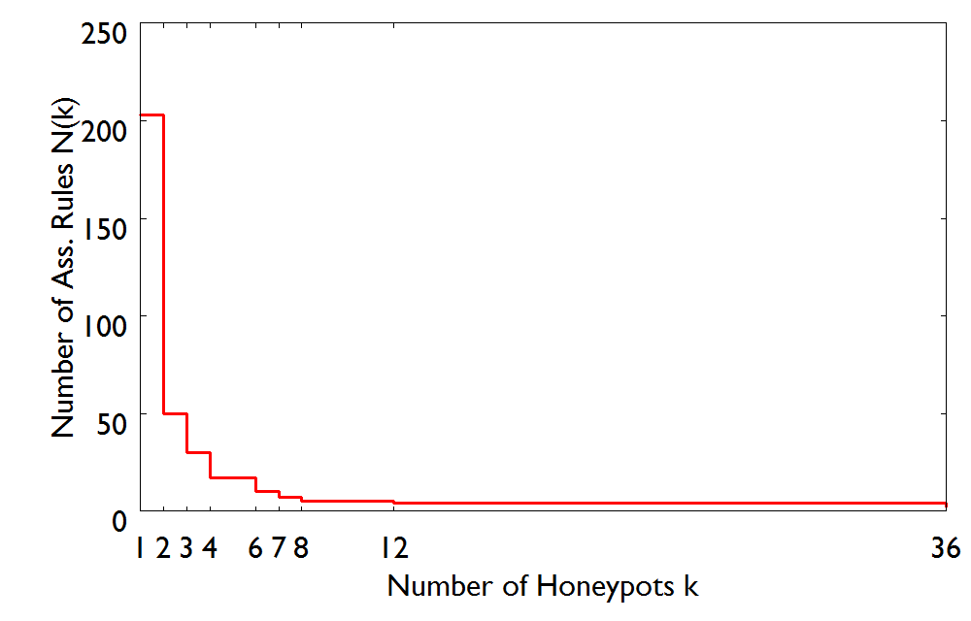
Exp3: Dependency on Honeypot
200 rules observed by
a single honeypot.
2 common rules observed by
36 honeypots.

Slide 17
Exp3: Dependency on Honeypot
The widely observed rules are
likely to be coordinated attacks!
200 rules observed by
a single honeypot.
2 common rules observed by
36 honeypots.

Slide 18
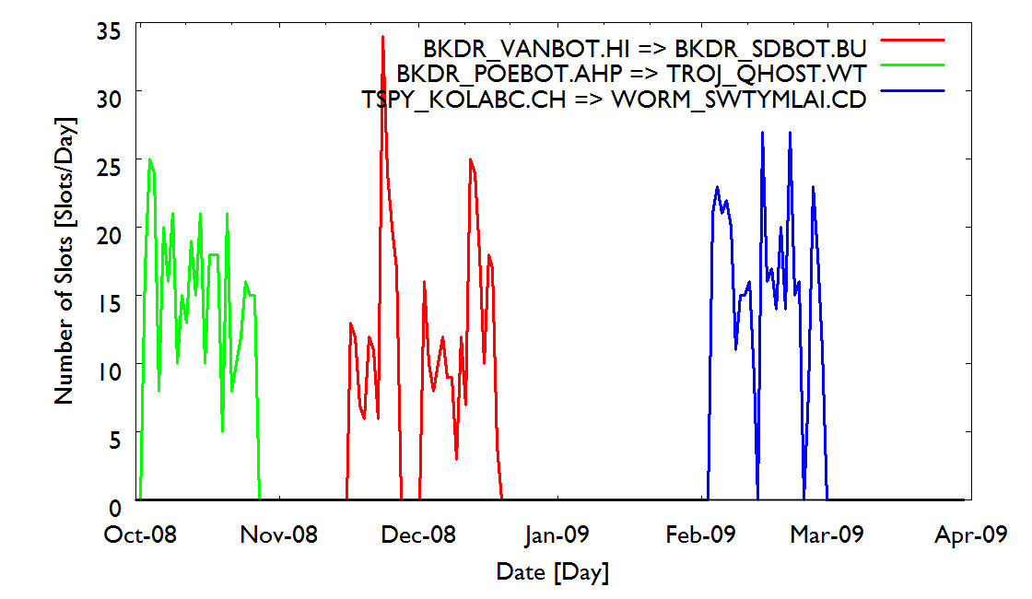
Exp4: Lifecycle of Rules of Malware

Slide 19
Exp4: Lifecycle of Rules of Malware
Lifecycle of coordinated attacks
26.3 days

Slide 20
Conclusions
We have proposed an automated method to detect the association rule of malware for coordinated attacks.
We have showed that our proposed method can extract all coordinate attacks correctly.
We have shown the strong correlation between PE, TROJ and WORM from our experiment.
The widely observed rules are likely to be coordinated attacks.
The duration of coordinated attacks is very short.

Slide 21
Thank You!

Slide 22
Experiment 3: Dependency on Honeypot
Num. of slots: 3 and over, Minimum Conf: 80%
No. | Antecedent |  |  | Consequent | Honey
1 |  | TROJ_BUZUS.AGB | ⇒ | WORM_SWTYMLAI.CD | 36
2 |  | WORM_SWTYMLAI.CD | ⇒ | TROJ_BUZUS.AGB | 36
3 | TROJ_BUZUS.AGB | BKDR_VANBOT.GN | ⇒ | WORM_SWTYMLAI.CD | 12
4 | WORM_SWTYMLAI.CD | BKDR_VANBOT.GN | ⇒ | TROJ_BUZUS.AGB | 12
5 |  | TROJ_DLOADR.CBK | ⇒ | UNKNOWN | 8
6 | WORM_SWTYMLAI.CD | PE_VIRUT.AV | ⇒ | TROJ_BUZUS.AGB | 7
7 | TROJ_BUZUS.AGB | PE_VIRUT.AV | ⇒ | WORM_SWTYMLAI.CD | 7
No. | Antecedent |  |  | Consequent | Honey
1 |  | TROJ_ BUZUS.AGB | ⇒ | WORM_ SWTYMLAI.CD | 36
2 |  | WORM_ SWTYMLAI.CD | ⇒ | TROJ_ BUZUS.AGB | 36
6 | WORM_ SWTYMLAI.CD | PE_ VIRUT.AV | ⇒ | TROJ_ BUZUS.AGB | 7
7 | TROJ_ BUZUS.AGB | PE_ VIRUT.AV | ⇒ | WORM_ SWTYMLAI.CD | 7

Slide 23
Experiment 4: Lifecycle of Rules of Malware
Num. of slots: 3 and over, Minimum Conf: 80%
MW | Antecedent |  |  | Consequent
PE | PE_ VIRUT.AV | WORM_ SWTYMLAI.CD | ⇒ | TSPY_ KOLABC.CH
TROJ |  | TROJ_ BUZUS.AGB | ⇒ | WORM_ SWTYMLAI.CD
WORM |  | TSPY_ KOLABC.CH | ⇒ | WORM_ SWTYMLAI.CD
Not TROJ but TSPY appeared!

