Slide 1
Apriori–PrefixSpan Hybrid Approach for Automated Detection of Botnet Coordinated Attacks
NBiS2011-S4: Network Security
Masayuki Ohrui, Hiroaki Kikuchi, Tokai University
Masato Terada, Hitachi, Ltd.
Nur Rohman Rosyid, KMITL

Slide 2
Generation of Malware
1. Single
2. Variants
3. Botnet
PE
PE
WO
TR
WORM
A
C
The Botnet
Coordinated
Attacks
B

Slide 3
Definition of Coordinated Attacks
Time | 1st Attack | C&C | Coordinated Attacks |  | User
0:00
1:00
1:30
1:30
PE
1st Attack
IRC
DNS
Command
WO
DNS
GET
TR

Slide 4
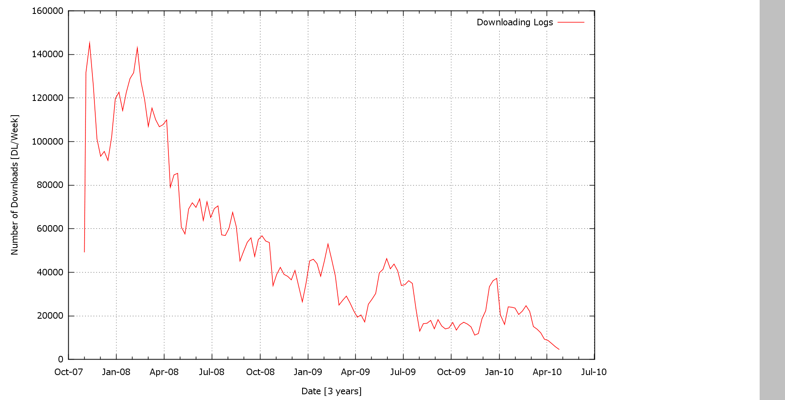
Number of Downloads (2007-2010)
Decreasing Tendency
Number of Downloads [DL/Week]
CCC DATAset [3 years]

Slide 5
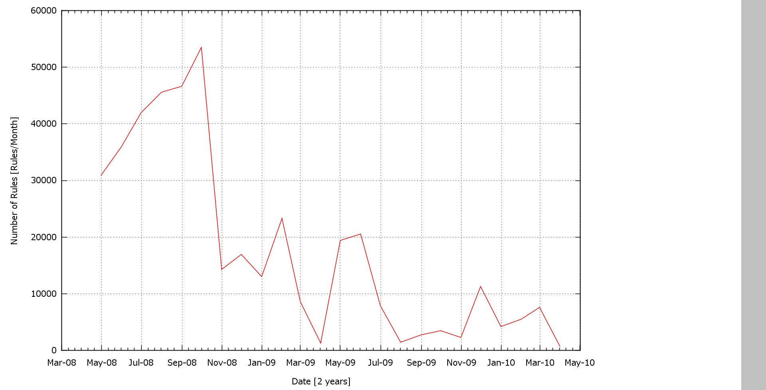
Avg. Length of Coordinated Attacks
Complication
Number of Rules [Rules/Month]
Number of Patterns [Patterns/Day]
CCC DATAset 2009 ～ 2010 [2 years]

Slide 6
Objectives
We aim to identify the botnet coordinated attacks with malware based on honeypot logs.
1. The complexity of malware patterns. $n^{3}$
2. Difficulty of the unstable patterns.
3. The size of dataset, which is too large to analyze.
Difficulty

Slide 7
Previous Works
M. Ohrui, H. Kikuchi and M, Terada, “Mining Association Rules Consisting of Download Servers from Distributed Honeypot Observation”, The 13th Int’l Conf. on Network-Based Information Systems (NBiS 2010), pp. 541-545, 2010.
N. R. Rosyid, M. Ohrui, H. Kikuchi and P. Sooraksa, M. Terada, “A Discovery of Sequential Attack Patterns of Malware in Botnets”, The 2010 IEEE Int’l Conf. on Systems, Man, and Cybernetics (SMC 2010), pp. 2564-2570, 2010.
1. Apriori
2. PrefixSpan

Slide 8
Comparison of 2 Algorythms
A set of items
unordered
if X then Y
Given honeypot log:
Sequence
in order
Same Time
PE
WO
TR
50 patterns (Answer)
1. Apriori
2. PrefixSpan
PE
WO
TR
PE
TR
WO
30/50 extracts
50/50 extracts
PE
TR
WO
20/50 extracts

Slide 9
1. Example of Apriori
X(PE1) ⇒ Y(WORM1 & TROJ1)
$$Supp=|X∩Y|/|N| =4/7 days (60\%) \\ Conf=|X∩Y|/|X| =4/5 days (80\%)$$
Week | PE1 | PE2 | WORM1 | WORM2 | TROJ1 | TROJ2
Sun | 3 |  |  | 2 | 1
Mon | 1 | 2 | 2 | 1 | 3 | 3
Tue | 2 |  | 2 |  | 1 | 2
Wed |  | 5 | 3 | 2 |  | 1
Thu | 1 |  | 1 | 4 | 3
Fri |  | 2 | 2 | 3
Sat | 3 | 1 | 1 |  | 5 | 3
$$|N|=7$$
$$|X|=5$$
$$|X∩Y|=4$$

Slide 10
2. Example of PrefixSpan
Given a sequence database and minimum support threshold 2.
<PE>: 5, <WO>: 5, <TR>: 5, <BK>: 2, and <TS>: 2
Seq. Database | Projected Database
 | <PE> | <PE WO> | <PE TR>
<PE WO TR> | <WO TR> | <TR>
<PE TR WO> | <TR WO> |  | <WO>
<BK PE TR TS WO> | <TR TS WO> |  | <TS WO>
<TS PE PE TR WO BK> | <PE TR WO BK> | <BK> | <WO BK>
<PE WO TR WO> | <WO TR WO> | <TR WO> | <WO>
Sequential Patterns
<PE>: 5 | <PE WO>: 5 | <PE WO TR>: 2 | <PE TR WO>: 4
 | <PE TR>: 5

Slide 11
Pros and Cons
Date | Apriori |  |  | PrefixSpan
 | Rule | Slots | True | Rule | Ptns | True
09/02/04 | BK,TS⇒WO | 14 | 14 | TS⇒BK⇒WO | 3 | 29
 |  |  |  | TS⇒WO⇒BK | 7
 |  |  |  | WO⇒BK⇒TS | 4
 |  |  |  | WO⇒TS⇒BK | 12
…
09/02/28 | BK,TS⇒WO | 7 | 7 | TS⇒WO⇒BK | 5 | 14
 | BK,WO⇒TS | 7 |  | WO⇒TS⇒BK | 3
Perfect detection
Many Patterns
False detection
TS⇒BK⇒WO | 2
BK⇒TS⇒WO | 2
WO⇒BK⇒TS | 1
BK⇒WO⇒TS | 1
Failed detection

Slide 12
Our Idea
Hybrid detection of Apriori and PrefixSpan.
Dataset
NO
Step.1
Apriori
PE, WO⇒TR
TS, WO⇒BK
…etc
Useless
YES
BK, TR⇒WO
Step.2
Prefix
Span
NO
TR⇒WO⇒BK: 10
WO⇒TR⇒BK: 12
BK⇒TR⇒WO: 4
BK⇒WO⇒TR: 3
TR⇒BK⇒WO: 3
WO⇒BK⇒TR: 3
Useless
YES
The Botnet
Coordinated Attacks
Detected.

Slide 13
Experiment

Slide 14
CCC DATAset 2008-2010
CCC DATAset have observed malware traffic at the Japanese tier-1 backbone under the Cyber Clean Center (CCC).
The malware downloading logs
112(2008), 94(2009), 92(2010) honeypot
3 years (November 01, 2007 -April 30, 2010)
The captured packets data
1 honeypot
2(2008), 2(2009), 7(2010) days

Slide 15
Evaluation
$$Recall=\frac{C}{B}=\frac{30}{50}=0.6$$
$$Precision=\frac{C}{A}=\frac{30}{40}=0.75$$
A. Detected rules
B. True rules
40 rules
50 rules
A
C
B
C. Correctly detected rules
30 rules
Recall
Precision

Slide 16
Accuracy
We can deduce from the data that hybrid approach is effective.
 | Apriori | PrefixSpan | Hybrid
Recall | 315/315 =1.0 | 482/575 = 0.84 | 545/575 = 0.95
Precision | 315/464 = 0.68 | 482/482 = 1.0 | 1.0

Slide 17
Conclusions
We have proposed the hybrid Approach of Apriori and PrefixSpan for automated detection of botnet coordinated attacks.
Our experiment shows that the proposed scheme improves accuracy of detection by recall of 0.95 and precision of 1.0.

Slide 18
Thank you!

