Slide 1
A Discovery of Sequential Attack Patterns of Malware in Botnets
Nur Rohman Rosyid
October 10-13, 2010
Istanbul - Turkey

Slide 2
Outlines
1
Botnet attack
2
PrefixSpan method
3
Results and Analysis
4
Conclusion

Slide 3
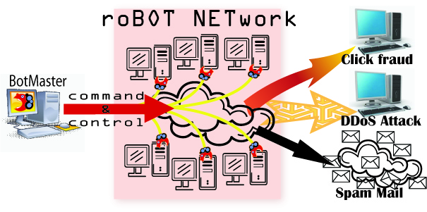
Botnet

Slide 4
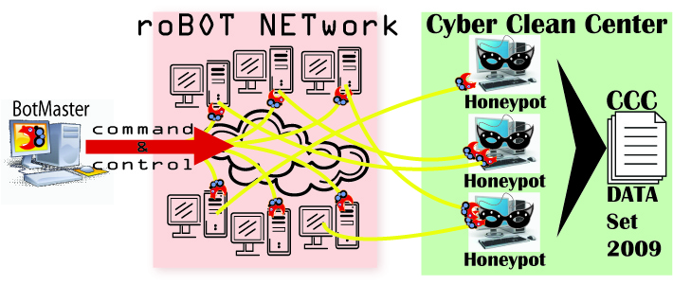
Honeypots
CCC DATA set 2009 consist of the access log of attack to 94 honeypots in 1 year (may 1, 2008 – April 30 2009).
This research observes one of the honeypot runs on Windows XP+SP1 and Windows 2000

Slide 5
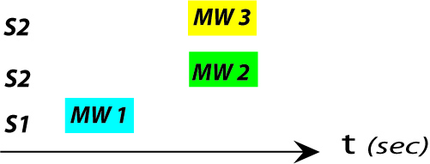
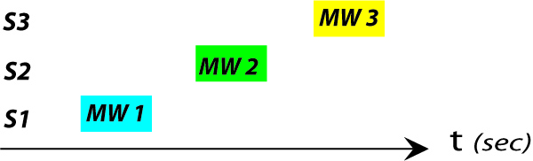
Coordinated attack
TSPY_ONLINEG.OPJ
TROJ_QHOST.WT BKDR_POEBOT.AHP
PE_VIRUT.AV
TSPY_KOLABC.CH
TROJ_AGENT.AGSB

Slide 6
Sequential pattern
It is difficult to find frequent sequential pattern of attacks in the big size of access log of attacks manually.
Sequence_id | Sequence
100 | <PE WO TR>
101 | <PE TR WO>
102 | <BK PE TR TS WO>
103 | <TS PE PE TR WO BK>
104 | <PE WO TR WO>
<PE TR WO>:4

Slide 7
Objective
Discover the frequent sequential attack pattern on CCC DATA set 2009

Slide 8
Method
Data mining algorithm to discover the frequent sub-sequences as patterns in a sequence database.
PrefixSpan¹ is an algorithm for efficient mining of sequential pattern in a huge dataset
  No candidate generation
  Low cost of computation
1) J. Pei, et al., ``PrefixSpan: Mining Sequential Patterns by Prefix-Projected Growth'‘, in Proc. of The 17th Int'l Conf. on Data Engineering, pp.215-224, 2001.

Slide 9
Method (count)
Example: Given a sequence database and minimum support threshold 2
Sequence_id | Sequence
100 | <PE WO TR>
101 | <PE TR WO>
102 | <BK PE TR TS WO>
103 | <TS PE PE TR WO BK>
104 | <PE WO TR WO>
Sequential Patterns
<PE WO>:5, <PE TR>:5, <PE WO TR>:2,<PE TR WO>:4
<WO TR>:2
<TR WO>:4
<TS WO>:2

Slide 10
Method (count)
Seq. Database | Projected Database
 | <PE> | <PE WO> | <PE TR>
<PE WO TR> | <WO TR> | <TR>
<PE TR WO> | <TR WO> |  | <WO>
<BK PE TR TS WO> | <TR TS WO> |  | <TS WO>
<TS PE PE TR WO BK> | <PE TR WO BK> | <BK> | <WO BK>
<PE WO TR WO> | <WO TR WO> | <TR WO> | <WO>
Sequential Patterns
<PE>:5 | <PE WO>:5 | <PE WO TR>:2 | <PE TR WO>:4
 | <PE TR>:5
<PE>:5, <WO>:5, <TR>:5, <BK>:2, and <TS>:2

Slide 11
Method (count)
Final result of mining sequential patern is
Sequential Patterns
<PE WO>:5, <PE TR>:5, <PE WO TR>:2,<PE TR WO>:4
<WO TR>:2
<TR WO>:4
<TS WO>:2

Slide 12
Pre-Processing Data
Slot_id | Sequence of Malware
0 | TROJ_SYSTEMHI.BQ
1 | KDR_AGENT.ANHZ UNKNOWN TROJ_SYSTEMHI.BQ DR_AGENT.ANHZ UNKNOWN
2 | PE_BOBAX.AH
3 | PE_BOBAX.AH UNKNOWN BKDR_AGENT.ANHZ
… | …
15323 | PE_VIRUT.AV TROJ_IRCBRUTE.BW WORM_AUTORUN.CZU
15324 | UNKNOWN PE_VIRUT.AV PE_VIRUT.AV WORM_AUTORUN.CZU TROJ_IRCBRUTE.BW

Slide 13
Experiment outlines
Result of mining
  sequential 2-patterns.
  sequential 3-patterns.
Distribution of attacks of duplicate 3-pattern. (figure 3)
Distribution of attacks of non-duplicate 3-pattern. (figure 4)
Attack pattern based on source IP address and timestamp.

Slide 14
1.a. Result of mining sequential 2-patterns
length
serial

Slide 15
1.a. Result of mining sequential 2-patterns (cnt)

Slide 16
1.b. Result of mining sequential 3-patterns

Slide 17
1.b. Result of mining sequential 3-patterns (cnt)

Slide 18
Hot Tip
Figure 3.a
The sequential attack 3-pattern is considered as a distribution form of command and control (C&C) of botnet system captured at Honeypot-1 in a year.

Slide 19
Hot Tip
Figure 3.b
The sequential attack 3-pattern is considered as a distribution form of command and control (C&C) of botnet system captured at Honeypot-2 in a year.

Slide 20
Hot Tip
Figure 4.a
8 days
20 days
25 days
(P1.3.21) PE_VIRUT.AV BKDR_SDBOT.BU BKDR_VANBOT.HI
(P1.3.27) BKDR_SCRYPT.ZHB BKDR_SDBOT.BU BKDR_VANBOT.HI
(P1.3.49) BKDR_SCRYPT.ZHB PE_VIRUT.AV BKDR_SDBOT.BU
A
(P1.3.4) TROJ_QHOST.WT, WORM_HAMWEQ.AP, BKDR_POEBOT.AHP
(P1.3.29) TSPY_ONLINEG.OPJ, TROJ_QHOST.WT, BKDR_POEBOT.AHP
(P1.3.30) BKDR_RBOT.CZO, WORM_HAMWEQ.AP, TROJ_QHOST.WT
C
Distribution of non-duplicate the sequential attack 3-patterns of malware within a year at honeypot -1
B
(P1.3.37) PE_VIRUT.AV TSPY_KOLABC.CH TROJ_AGENT.AGSB

Slide 21
Hot Tip
Figure 4.b
8 days
20 days
25 days
(P2.3.54) BKDR_SCRYPT.ZHB PE_VIRUT.AV BKDR_SDBOT.BU
(P2.3.24) BKDR_SCRYPT.ZHB BKDR_VANBOT.HI BKDR_SDBOT.BU
(P2.3.14) PE_VIRUT.AV BKDR_VANBOT.HI BKDR_SDBOT.BU
(P2.3.29) TSPY_ONLINEG.OPJ BKDR_POEBOT.AHP TROJ_QHOST.WT
(P2.3.15) BKDR_RBOT.CZO WORM_HAMWEQ.AP TROJ_QHOST.WT
(P2.3.4) BKDR_POEBOT.AHP WORM_HAMWEQ.AP TROJ_QHOST.WT
Distribution of non-duplicate the sequential attack 3-patterns of malware within a year at honeypot -2
C
(P2.3.20) PE_VIRUT.AV TSPY_KOLABC.CH TROJ_AGENT.AGSB
A
B

Slide 22
The common features of non-dulicate sequential attack 3-pattern are
These patterns occured intensively within the sort time period.
The number of slots that have been infected are greater than the duplicate patterns.
Each group of attack has been performed by multiple 3-patterns except group C.

Slide 23
4. Attack pattern based on source IP address and timestamp
Pattern P_{1.3.29}
Pattern P_{2.3.49}
TSPY_ONLINEG.OPJ
TROJ_QHOST.WT BKDR_POEBOT.AHP
BKDR_SCRYPT.ZHB
PE_VIRUT.AV
BKDR_SDBOT.BU
P1.3.29
P2.3.49

Slide 24
Conclusion
Coordinated attacks are performed by multiple sequential attack patterns within a short time period.
The sequential pattern of coordinated attacks tends to change all the time.
The types of malware do not have a high of operating system dependency, but the sequence of malware within a pattern has operating system dependency.
PrefixSpan method sufficiently discover all sequential attack patterns.
This result gives several behaviors useful for alerting threats of botnets’ attacks.

Slide 25
Thank You!

